Slide 1
AISC1003 Machine Learning I

Slide 2
Learning Outcomes – ML I – LR II – Gradient Descent
You will learn a new ML technique called Gradient Descent,
Understanding the derivation of where it comes from, and
How it compares to OLSR
You will see a worked example of LR using GD

Slide 3
Exercises– Week 2
For the following data set, find/plot the fit, and the correlation using python & excel. Compare to Excel’s trendline. Plot the residuals, then rank them, notice anything.
x | y | x | y | x | y
0 | 12.30257 | 10 | 106.9244 | 21 | 136.0519
1 | 20.1944 | 11 | 115.7368 | 22 | 160.7053
2 | 53.47424 | 12 | 74.14187 | 23 | 184.7324
3 | 60.52269 | 13 | 126.5221 | 24 | 152.8735
4 | 61.85855 | 14 | 119.9432 | 25 | 164.4765
5 | 70.42899 | 15 | 139.9098 | 26 | 169.6488
6 | 86.55053 | 16 | 133.7649 | 27 | 187.0767
7 | 54.28762 | 17 | 152.9818 | 28 | 174.1397
8 | 69.02268 | 18 | 157.5315 | 29 | 217.3314
9 | 100.4699 | 19 | 164.2307 | 30 | 198.0507
10 | 106.9244 | 20 | 130.2153

Slide 4
Exercises– Week 2

Slide 5
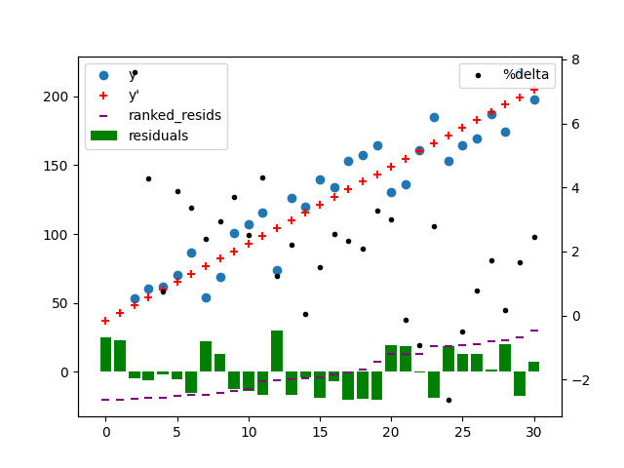
Exercises– Week 2
import pandas as pd
import numpy as np
import matplotlib.pyplot as plt
#Read excel file
df=pd.read_excel('exercises-wk2.xlsx')
#keep cols 2 and 3, rename columns per row 1, keep needed rows
df=df.iloc[:, 1:3]
df.columns = df.iloc[0]
df = df[1:32]
#slope, m=(Σyixi-y̅iΣxi)/(Σxi2-x̅iΣxi)
m=(sum(df["x"]*df["y"])-df["y"].mean()*sum(df["x"]))/(sum(df["x"] * df["x"])-df["x"].mean()*sum(df["x"]))
#b=y̅i-mx̅i
b=df["y"].mean()-m*df["x"].mean()
#Predictions
df["y_hat"]=df['x']*m+b
#residual analysis
df["residuals"]=df["y_hat"]-df["y"]
df["ranked_residuals"]=df["residuals"].sort_values(ascending=True).values
df["temp"]=(df["ranked_residuals"]+abs(df["ranked_residuals"].head(1).item()))
df["%jump"]=(df["ranked_residuals"]+abs(df["ranked_residuals"].head(1).item())).pct_change()*100
#r^2
rsqr=sum((df["y_hat"]-df["y"].mean())*(df["y_hat"]-df["y"].mean()))/sum((df["y"]-df["y"].mean())*(df["y"]-df["y"].mean()))
print('m:',m,' b:',b," rsqr:",rsqr)
print(df)
#graph
fig=plt.figure()
ax1 = fig.add_subplot(111)
ax1.scatter(df['x'],df['y'], marker='o', label='y')
ax1.scatter(df['x'],df['y_hat'], marker='+', color="red", label="y'")
ax1.bar(df['x'],df['residuals'], width=0.8, color="green", label="residuals")
ax1.scatter(df['x'],df['ranked_residuals'], marker='_', color="purple", label="ranked_resids")
plt.legend()
ax2 = ax1.twinx()
ax2.scatter(df['x'],np.log(df['%jump']), marker='.', color="black", label="%delta")
ax2.legend(loc=0)
plt.show()

Slide 6
Exercises– Week 2
Filenames!
No blackbox.
____________________________________________________________________________________________________________________
We can use any method or medium but at the end the result would be same irrespective
of using Python or Excel.
____________________________________________________________________________________________________________________
Hi Prof
Student Name – hjkhkjjkh jkhkjhkjhkjhk
Student Id – 76898689769876987
Program/Starting Year – M07J / Winter 2022
Given exercise - https://moodle.tbcollege.com/moodle/pluginfile.php/2986134/mod_resource/content/1/Exercises-wk2.pdf
Since I was not clear that the given data set needs to be considered as one dataset or three different datasets, So, I tried to plot a chart for both ways in excel.
Considered 3 data set in three sheets (first 3 tabs of attached xls), plotted, calculated R, R^2, Ranked these 3 datasets. (Also, I learn how to add a linear line there and show up the equation and R^2 values)
Considered these all as 1 dataset (consolidated tab of xls), plotted and calculated R, R^2.
In python, I plotted it as 1 dataset only, just to cross-check, if the linear regression plot appears the same as excel or not.
Observations: 1st dataset looks highly co-related among the other 2.

Slide 7
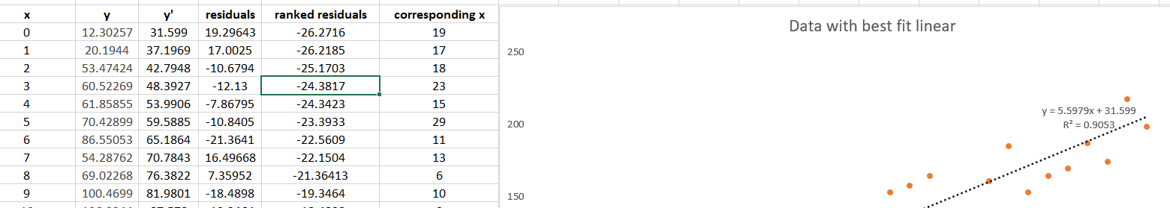
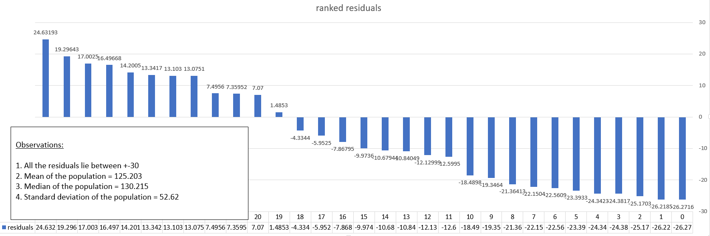
Exercises– Week 2

Slide 8
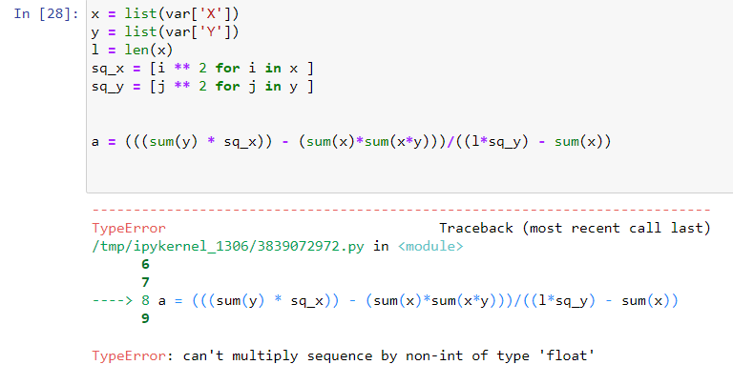
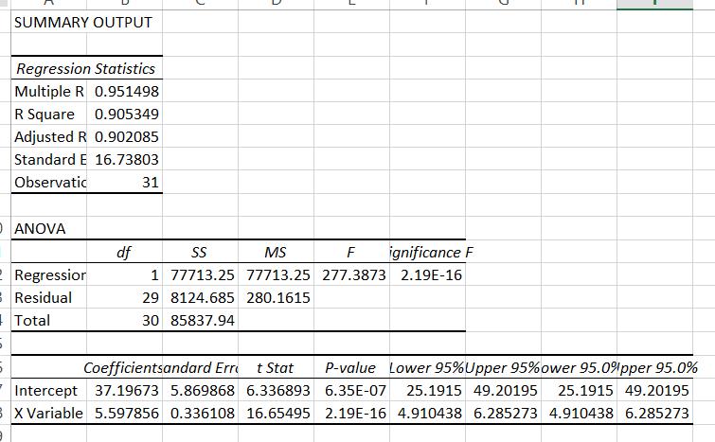
Exercises– Week 2

Slide 9

Exercises– Week 2
______________________________________________________________________________________________
Hello Sir,
Attaching the excel sheet and my interactive python notebook with the fit calculations and plotting.
I had some confusions around fit calculations (number of datasets) and with your references from the slides and the ones you provided in the asynchronous pdf I’ve tried few different ways to calculate them and added in the excel sheet. I was able to cross verify the calculations and result matched for me and was able to learn different ways to calculate coefficients and correlations.
Also with limited knowledge of Python and taking reference from python documentation I could just plot the variables with values on the graph.

Slide 10
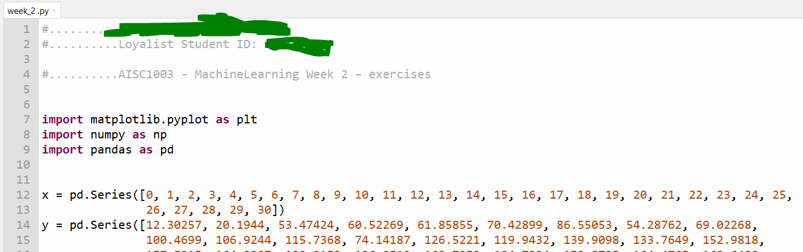
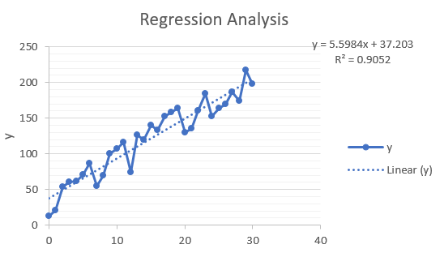
Exercises– Week 2
Conclusion We can see that the value of R² is very close to "1" which depicts that it a very good line of fit. Additionaly, we can see that the trendline or the line of best fit is very close to all of the data points which makes it a strong positive correlation.
Conclusion:
From the above graph we can conclude that, X and Y are strongly positively correlated and more the value of X, higher is the value of Y

